Slide 1
Arrays
Lecture # 10

Slide 2
Arrays
Array is a collection of variables of the same data type placed contiguously in memory.
The items or elements of array are accessed by index number.
Arrays can be used to store basic data types, i.e. int, char and float etc.
Arrays can also be used as data members in classes.
Array can also be used to hold objects.
Arrays can also by used in structures, i.e. we can create an array of variable of structure types and we can use array even inside the structures for defining its members etc.

Slide 3
Arrays Example 1
#include<iostream.h>
#include<conio.h>
void main(void)
{ clrscr();
int t[7], sum=0;
for(int a=0;a<=6;a++)
{ cout<<"Enter Temperature for day "<<a+1<<" ";
  cin>>t[a];
  sum += t[a];
}
for(a=0;a<=6;a++)
cout<<"Temperature of day "<<a+1<<" is "<<t[a]<<endl;
cout<<"\nAverage temperature is "<<sum/7;
getch();
}

Slide 4
Arrays Example 1
Output
  Enter Temperature for day 1 34
  Enter Temperature for day 2 32
  Enter Temperature for day 3 33
  Enter Temperature for day 4 35
  Enter Temperature for day 5 36
  Enter Temperature for day 6 41
  Enter Temperature for day 7 32
  Temperature of day 1 is 34
  Temperature of day 2 is 32
  Temperature of day 3 is 33
  Temperature of day 4 is 35
  Temperature of day 5 is 36
  Temperature of day 6 is 41
  Temperature of day 7 is 32
  Average temperature is 34

Slide 5
Arrays Example 2
#include<iostream.h>
#include<conio.h>
void main(void)
{
clrscr();
int a[5], b[5];
for(int n=0;n<=4;n++)
{ cout<<"Enter value in element no. "<<n+1<<" ";
cin>>a[n];
b[n] = a[n] * a[n];
}
cout<<"Array A\tArray B"<<endl;
for(n=0;n<=4;n++)
cout<<a[n]<<"\t"<<b[n]<<endl;
getch();
}

Slide 6
Arrays Example 2
Output
Enter value in element no. 1 3
Enter value in element no. 2 4
Enter value in element no. 3 5
Enter value in element no. 4 6
Enter value in element no. 5 7
Array A Array B
3 9
4 16
5 25
6 36
7 49

Slide 7
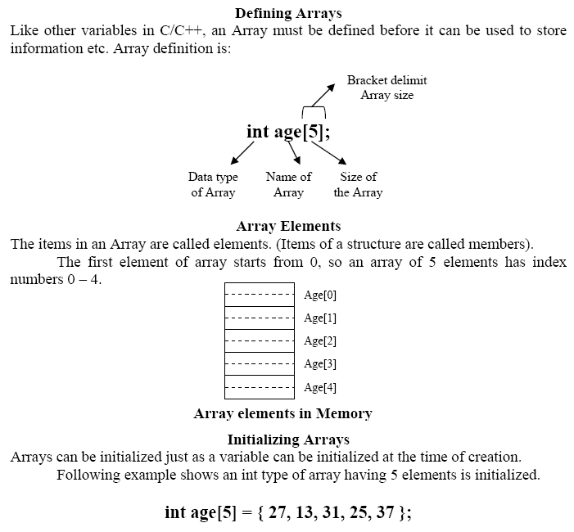

Slide 8
Multidimensional Arrays
Arrays can be multidimensional.
A two dimensional array consists of Rows and Columns as we have them in a matrix.
Following example shows multidimensional array created as having 4 Rows and 3 Columns.
int matrix[4][3];

Slide 9
Multidimensional Arrays
#include<iostream.h>
#include<conio.h>
const int ROW = 4;
const int COLUMN = 3;
void main(void)
{ clrscr();
int matrix[ROW][COLUMN];
for(int a=0;a<ROW;a++)
for(int b=0;b<COLUMN;b++)
{ cout<<"Enter ROW "<<a+1<<" COLUMN "<<b+1<<" ";
cin>>matrix[a][b];
}
for(a=0;a<ROW;a++)
{ for(b=0;b<COLUMN;b++)
cout<<matrix[a][b]<<"\t";
cout<<endl;
}
getch();
}

Slide 10
Multidimensional Arrays
Output
Enter ROW 1 COLUMN 1 1
Enter ROW 1 COLUMN 2 2
Enter ROW 1 COLUMN 3 3
Enter ROW 2 COLUMN 1 4
Enter ROW 2 COLUMN 2 5
Enter ROW 2 COLUMN 3 6
Enter ROW 3 COLUMN 1 7
Enter ROW 3 COLUMN 2 8
Enter ROW 3 COLUMN 3 9
Enter ROW 4 COLUMN 1 10
Enter ROW 4 COLUMN 2 11
Enter ROW 4 COLUMN 3 12
1 2 3
4 5 6
7 8 9
10 11 12

Slide 11
Passing Arrays to Functions
#include<iostream.h>
#include<conio.h>
const int LENGTH=7;
void show(int[LENGTH]);
void main(void)
{ clrscr();
int t[LENGTH];
for(int a=0;a<LENGTH;a++)
{
cout<<"Enter Temperature for day” <<a+1<<" ";
cin>>t[a];
}
show(t);
getch();
}

Slide 12
Passing Arrays to Functions
void show(int temperature[LENGTH])
{ int s=0;
for(int a=0;a<LENGTH;a++)
{
cout<<"\nTemperature for day "<<a+1<<" is ";
cout<<temperature[a];
s += temperature[a];
}
cout<<"\nSum of Temperatures is "<<s;
cout<<"\nAverage of Temperature is "<<s/LENGTH;
}

Slide 13
Array of Structures
#include<iostream.h>
#include<conio.h>
const int LENGTH = 3;
struct part
{ int mn;
int pn;
float cost;
};
void main(void)
{
clrscr();
part p[LENGTH];
for(int a=0;a<LENGTH;a++)
{
  cout<<"\nItem Number "<<a+1<<endl;
  cout<<"Enter Model Number ";
  cin>>p[a].mn;
  cout<<"Enter Part Number ";
  cin>>p[a].pn;
  cout<<"Enter Cost ";
  cin>>p[a].cost;
}
clrscr();
for(a=0;a<LENGTH;a++)
{
  cout<<"\nItem Number "<<a+1<<endl;
  cout<<"\nModel Number "<<p[a].mn;
  cout<<"\nPart Number "<<p[a].pn;
  cout<<"\nCost is "<<p[a].cost<<" Rs. "<<endl;
}
getch();
}

Slide 14
Storage Classes of Variables
There are three storage classes of variables
  Automatic Variables
  External Variables
  Static Variables

Slide 15
Static Variables
#include<iostream.h>
#include<conio.h>
float getAverage(float);
void main(void)
{ clrscr();
float data=1, average;
while(data!=0)
{ cout<<"Enter a number ";
cin>>data;
average = getAverage(data);
cout<<"New Average is "<<average<<endl;
}
getch();
}
float getAverage(float newdata)
{ static float total = 0;
static int count = 0;
count++;
total += newdata;
return total / count;
}
Output
Enter a number 5
New Average is 5
Enter a number 15
New Average is 10
Enter a number 25
New Average is 15
Enter a number 35
New Average is 20
Enter a number 10
New Average is 18
Enter a number 20
New Average is 18.333334
Enter a number 30
New Average is 20
Enter a number 0
New Average is 17.5

